Slide 1







Winning the Race of Space
Muhammad Waris
15th June 2024

Slide 2



Outline
Executive Summary
Introduction
Methodology
Results
Visualization – Charts
Dashboard
Conclusion
Appendix

Slide 3

Executive Summary
Summary of methodologies
Data Collection through API
Data Collection with Web Scraping
Data Wrangling
Exploratory Data Analysis with SQL
Exploratory Data Analysis with Data Visualization
Interactive Visual Analytics with Folium
Machine Learning Prediction
Summary of all results
Exploratory Data Analysis Result
Interactive Analytics with Screenshots
Predictive Analytics Result

Slide 4

Introduction
Project background and context
Space X advertises Falcon 9 rocket launches on its website with a cost of 62 million dollars; other providers cost upward of 165 million dollars each, much of the savings is because Space X can reuse the first stage. Therefore, if we can determine if the first stage will land, we can determine the cost of a launch. This information can be used if an alternate company wants to bid against space X for a rocket launch. This goal of the project is to create a machine learning pipeline to predict if the first stage will land successfully.
Problems you want to find answers
What factors determine if the rocket will land successfully?
The interaction amongst various features that determine the success rate of a successful landing.
What operating conditions needs to be in place to ensure a successful landing program.

Slide 5

Methodology

Slide 6
Methodology
Data collection methodology:
Data was collected using SpaceX API and web scraping from Wikipedia.
Perform data wrangling
One-hot encoding was applied to categorical features
Perform exploratory data analysis (EDA) using visualization and SQL
Perform interactive visual analytics using Folium and Plotly Dash
Perform predictive analysis using classification models

Slide 7
Data Collection
The data was collected using different methods which are as follow:
Data Collection was done by using get request to the SpaceX API
Next, we decoded the response content using .json() function call and converted it into a pandas dataframe using .json_normalize().
We then proceeded to clean the data, checked for missing values and fill in missing values where it was needed.
In addition, we performed web scraping on Wikipedia to obtain Falcon 9 launch records using BeautifulSoup.
Our objective was to extract the launch records from an HTML table, parse the table and convert it to a pandas dataframe for future analysis.

Slide 8
Data Collection – SpaceX API
We used the get request to the SpaceX API to collect data, clean the requested data and did some basic data wrangling and formatting.
The link to the notebook is
https://github.com/Waris99/Final-Capstone/blob/main/jupyter-labs-spacex-data-collection-api.ipynb

Slide 9
Data Collection - Scraping
We applied web scrapping to the records of Falcon 9 launch with BeautifulSoup
We parsed the table and converted it into a pandas dataframe.
The link to the notebook is
https://github.com/Waris99/Final-Capstone/blob/main/jupyter-labs-webscraping.ipynb

Slide 10
Data Wrangling
We performed exploratory data analysis
We calculated the number of launches at each site, and the number and occurrence of each orbits
We created landing outcome label from outcome column and exported the results to csv.
The link to the notebook is
https://github.com/Waris99/Final-Capstone/blob/main/labs-jupyter-spacex-Data%20wrangling.ipynb

Slide 11
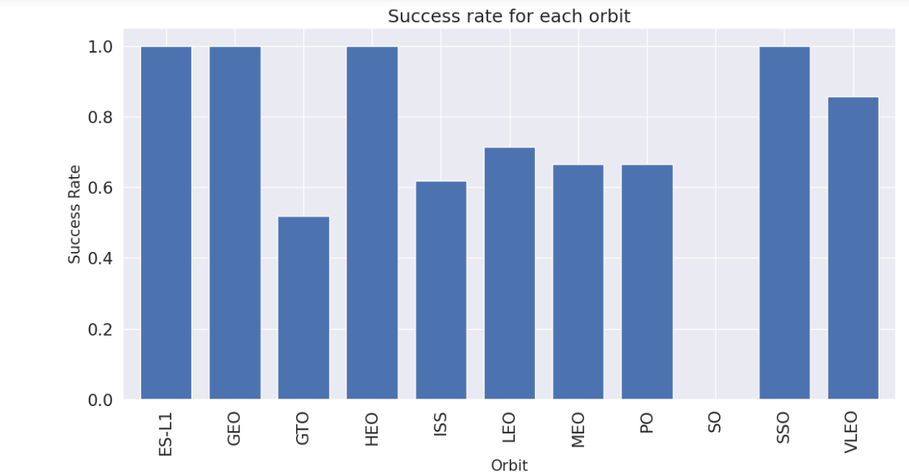
EDA with Data Visualization
We explored the data by visualizing the relationship between flight number and launch Site, payload and launch site, success rate of each orbit type, flight number and orbit type, the launch success yearly trend.
The link to the notebook is
https://github.com/Waris99/Final-Capstone/blob/main/jupyter-labs-spacex-data%20visualization.ipynb

Slide 12
EDA with SQL
We loaded the SpaceX dataset into a PostgreSQL database without leaving the jupyter notebook.
We applied EDA with SQL to get insight from the data. We applied different queries to find out for instance:
The names of unique launch sites in the space mission.
The total payload mass carried by boosters launched by NASA (CRS)
The average payload mass carried by booster version F9 v1.1
The total number of successful and failure mission outcomes
The failed landing outcomes in drone ship, their booster version and launch site names.
The link to the notebook ishttps://github.com/Waris99/Final-Capstone/blob/main/jupyter-labs-eda-sql-coursera_sqllite.ipynb

Slide 13
Build an Interactive Map with Folium
We marked all launch sites, and added map objects such as markers, circles, lines to mark the success or failure of launches for each site on the folium map.
We assigned the feature launch outcomes (failure or success) to class 0 and 1.i.e., 0 for failure, and 1 for success.
We calculated the distances between a launch site to its proximities. We answered some question for instance:
Are launch sites near railways, highways and coastlines.
Do launch sites keep certain distance away from cities.
The link to notebook is https://github.com/Waris99/Final-Capstone/blob/main/lab_jupyter_launch_site_location.ipynb

Slide 14
Build a Dashboard with Plotly Dash
We built an interactive dashboard with Plotly dash
We plotted pie charts showing the total launches by a certain sites
We plotted scatter graph showing the relationship with Outcome and Payload Mass (Kg) for the different booster version.
The link to the notebook ishttps://github.com/Waris99/Final-Capstone/blob/main/app.py

Slide 15
Machine Learning: Predictive Analysis
We loaded the data using numpy and pandas, transformed the data, split our data into training and testing.
We built different machine learning models and tune different hyperparameters using GridSearchCV.
We used accuracy as the metric for our model
We found the best performing classification model.
The link to the notebook is https://github.com/Waris99/Final-Capstone/blob/main/SpaceX_Machine%20Learning%20Prediction.ipynb

Slide 16
Results
Exploratory data analysis results
Demo of Interactive analytics in screenshots
Predictive analysis results

Slide 17
Insights Drawn From EDA

Slide 18
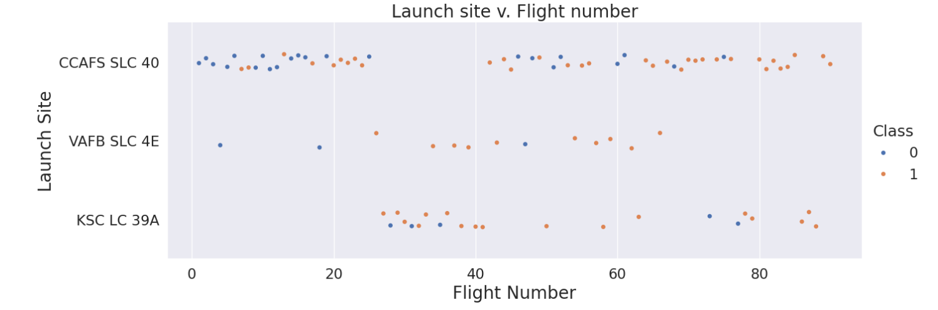
Flight Number vs. Launch Site
From the plot, we found that the larger the flight amount at a launch site, the greater the success rate at a launch site

Slide 19
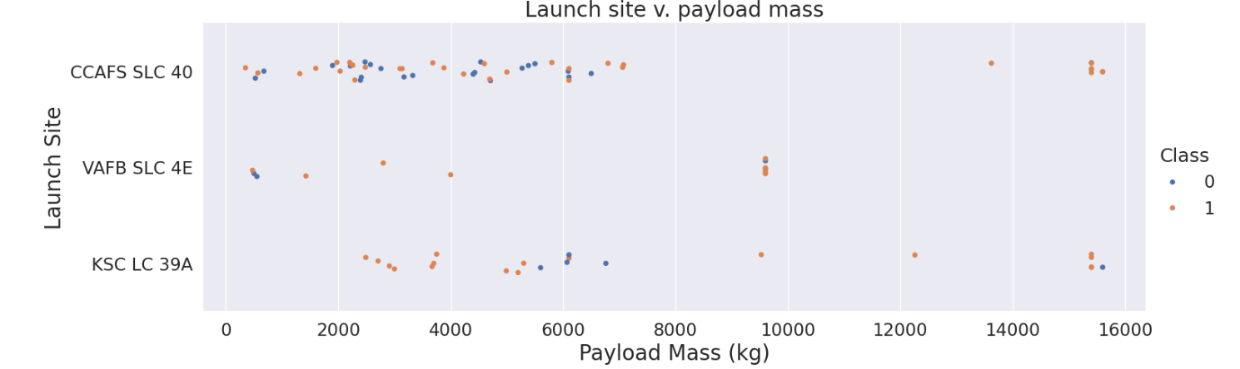
Payload vs. Launch Site
The greater the payload mass for the site CCAFS SLC 40 the higher the success rate for the rocket

Slide 20
Success Rate vs. Orbit Type
From the plot, we can see that ES-L1, GEO, HEO, SSO, VLEO had the most success rate.

Slide 21
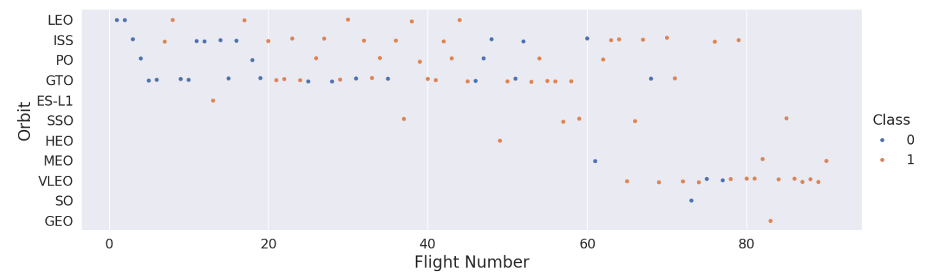
Flight Number vs. Orbit Type
The plot below shows the Flight Number vs. Orbit type. We observe that in the LEO orbit, success is related to the number of flights whereas in the GTO orbit, there is no relationship between flight number and the orbit.

Slide 22
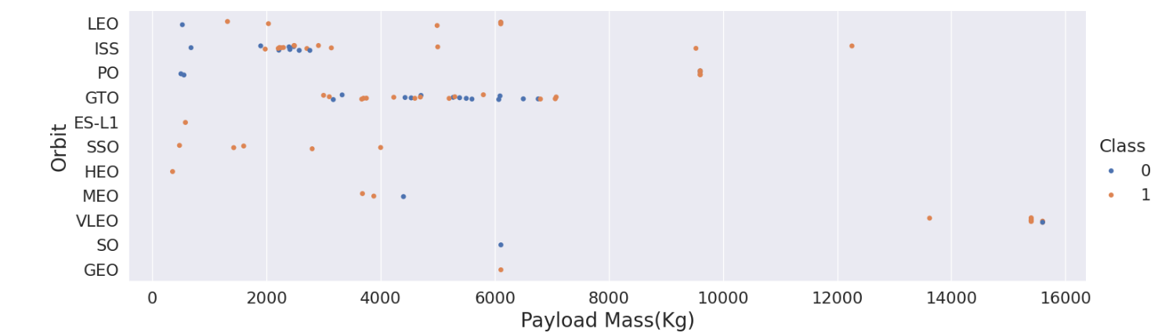
Payload vs. Orbit Type
We can observe that with heavy payloads, the successful landing are more for PO, LEO and ISS orbits.

Slide 23
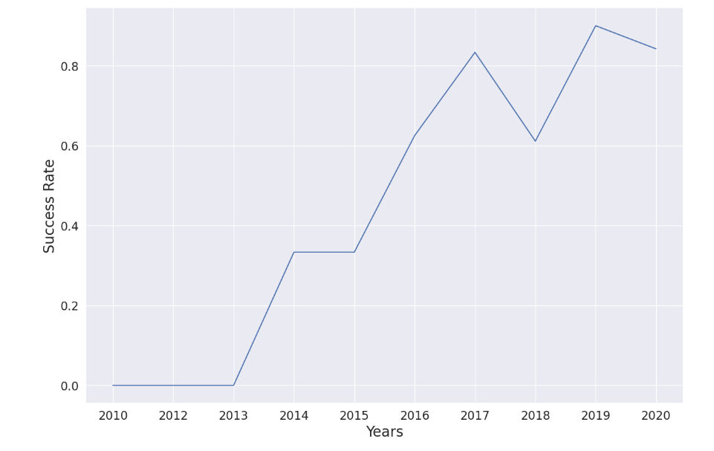
Launch Success Yearly Trend
From the plot, we can observe that success rate since 2013 kept on increasing till 2020.

Slide 24
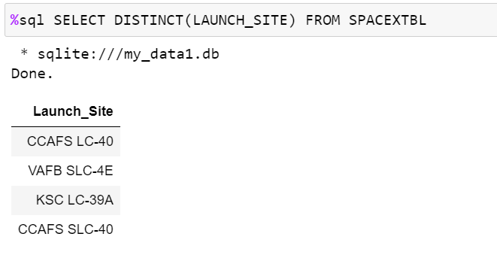
All Launch Site Names
We used the Distinct key word to show the Unique launch sites from SpaceX Data.

Slide 25
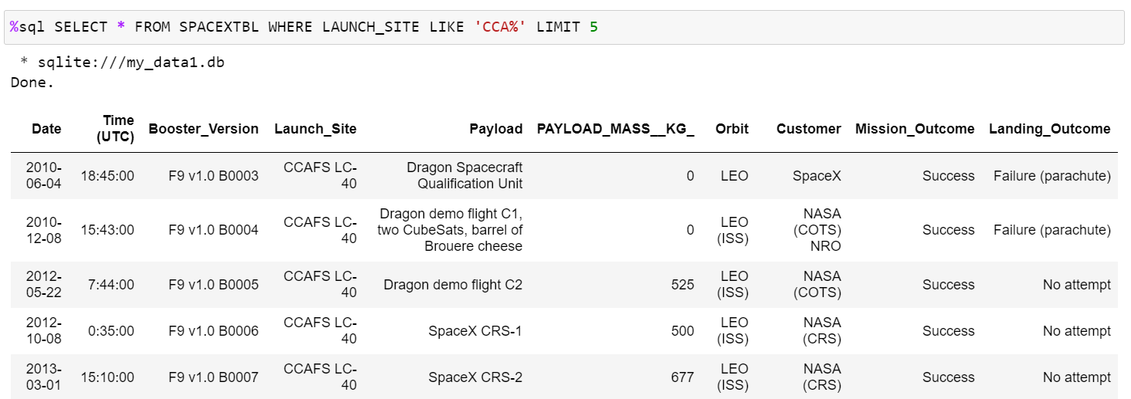
Launch Site Names Begin with ‘CCA’
We used the above query to display the 5 records of launch sites begin with ‘CCA’

Slide 26
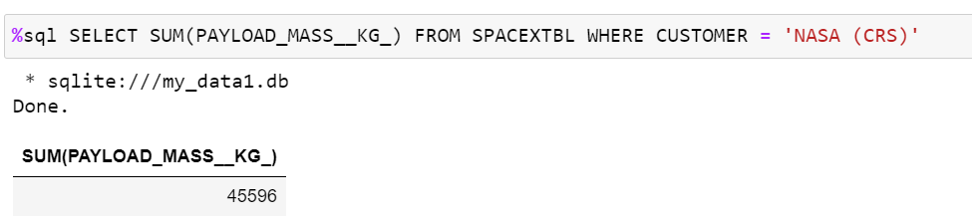
Total Payload Mass
We calculated the total payload mass carried by the boosters from NASA as 45596 using the below query

Slide 27
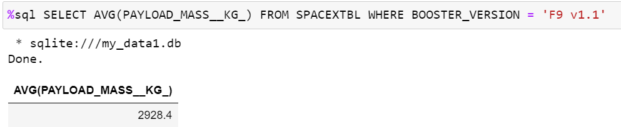
Average Payload Mass by F9 v1.1
The average payload mass carried by the F9 v1.1 was 2928.4 as calculated.

Slide 28
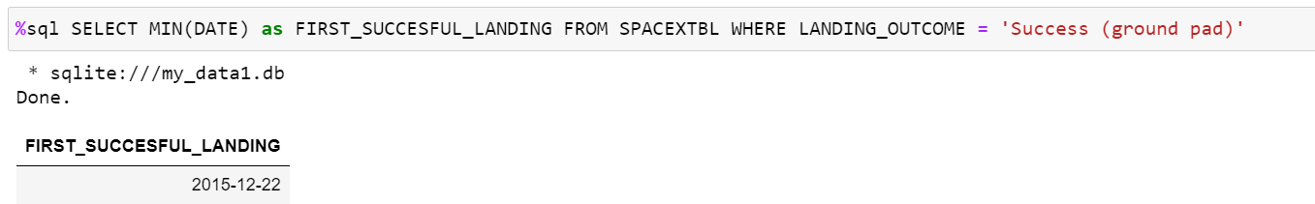
First Successful Ground Landing Date
We observed that the dates of the first successful landing on ground pad was 22nd December 2015

Slide 29
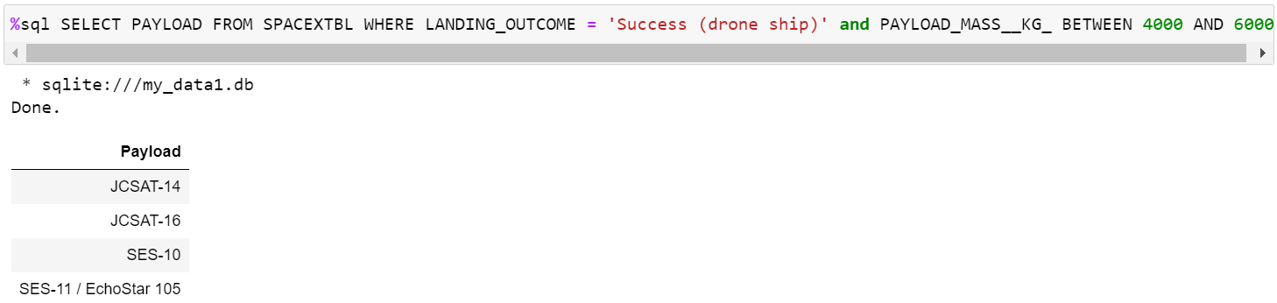
Successful Drone Ship Landing with Payload Mass Between 4000 and 6000
We used the WHERE clause to filter the desired result for boosters which have successfully landed on drone ship and applied the AND condition to determine successful landing with payload mass between 4000 and 6000

Slide 30
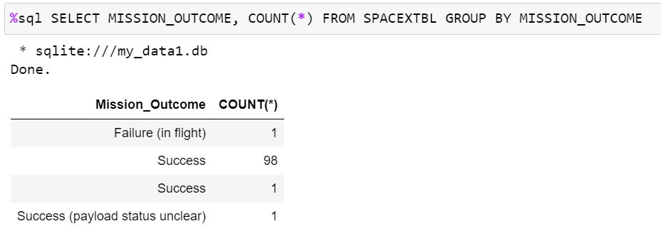
Total Number of Successful and Failure Mission Outcomes
We used wildcard like ‘%’ to filter the result for WHERE Mission Outcomes was a success or failure

Slide 31
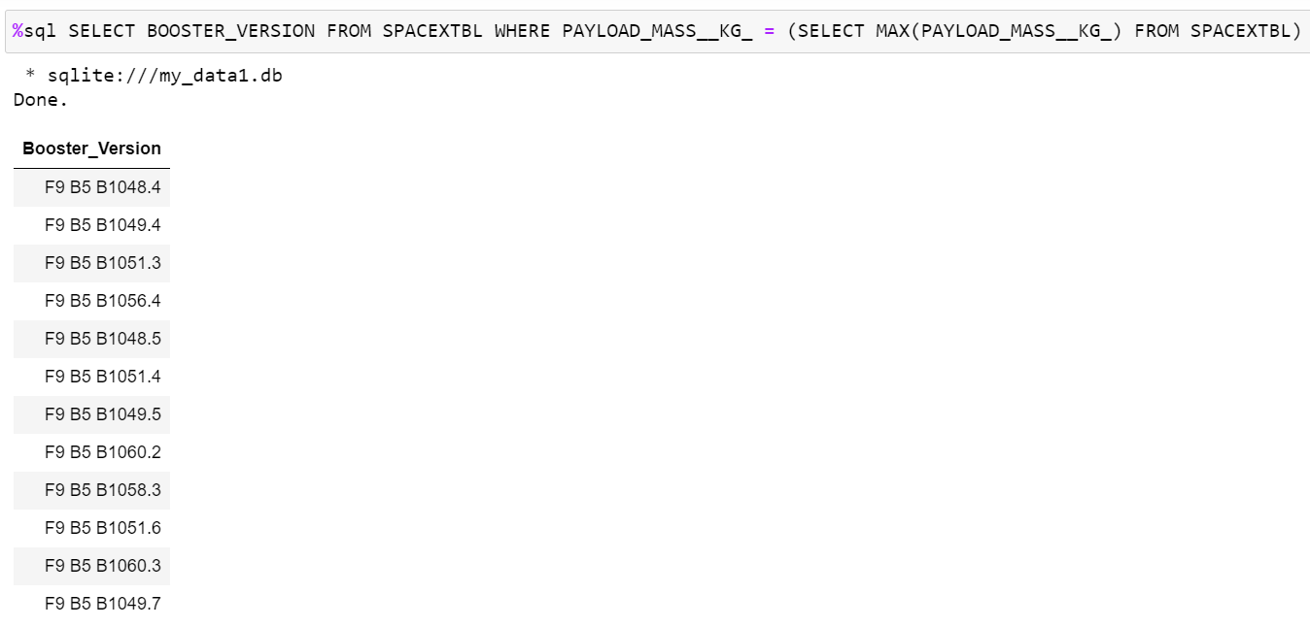
Boosters Carried Maximum Payload
We determine the booster that have carried the maximum payload using a subquery in the WHERE clause and the MAX() function

Slide 32
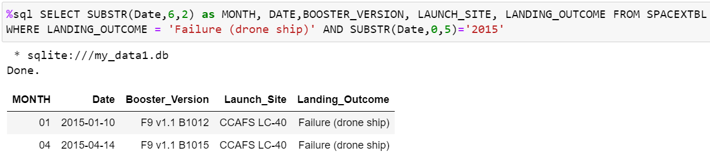
2015 Launch Records
We used a combinations of the WHERE clause, LIKE, NAD, and BETWEEN conditions to filter for failure landing outcomes in drone ship, their booster versions, and launch site names for year 2015

Slide 33
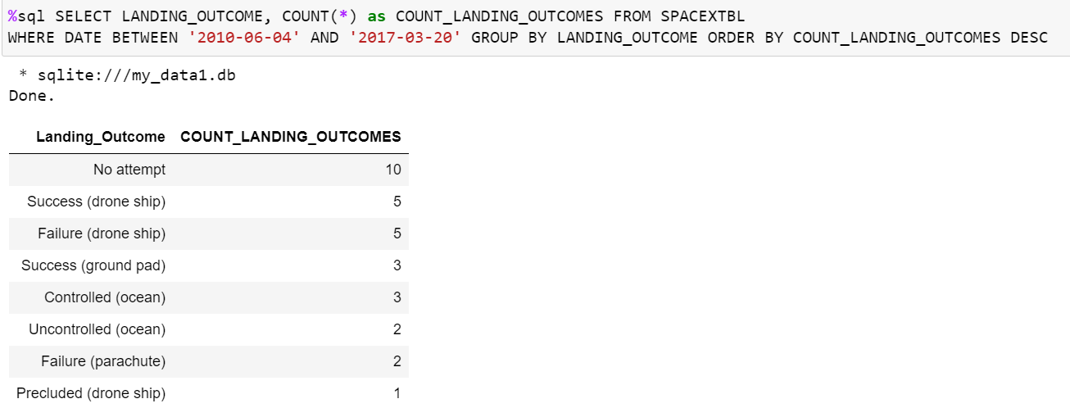
Ranking Landing Outcomes Between 2010-06-04 and 2017-03-20
We selected Landing Outcomes and the COUNT of landing outcomes for the data and used WHERE clause to filter the result for landing outcomes BETWEEN 2010-06-04 to 2010-03-20
We applied the GROUP BY clause to group the landing outcomes and the ORDER BY clause to order the grouped landing in descending order

Slide 34
Launch Sites Proximities Analysis

Slide 35
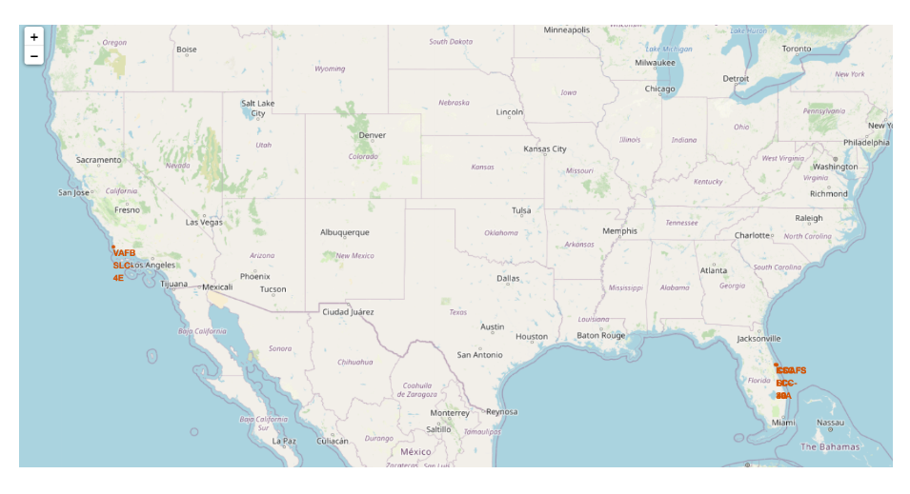
All launch Sites Global Map Maker
We ca see that the launch sites are in the United States of America coasts Florida and California

Slide 36
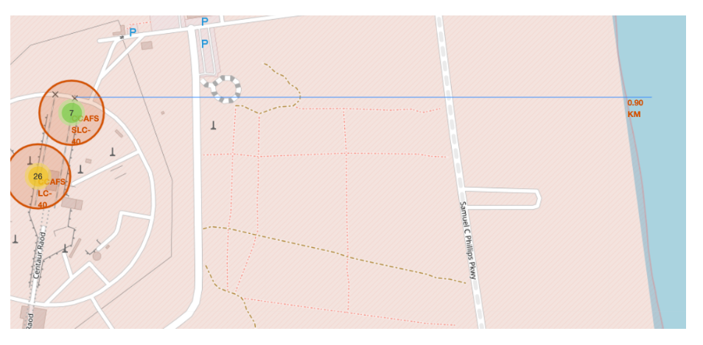
Launch Site Distance to Landmarks
Are launch sited in close proximity to railways? N0
Are launch sites in close proximity to highways? No
Are launch sites in close proximity to coastline? No
Do launch sites keep certain distance away from cities? Yes

Slide 37

Build a Dashboard with Plotly Dash

Slide 38
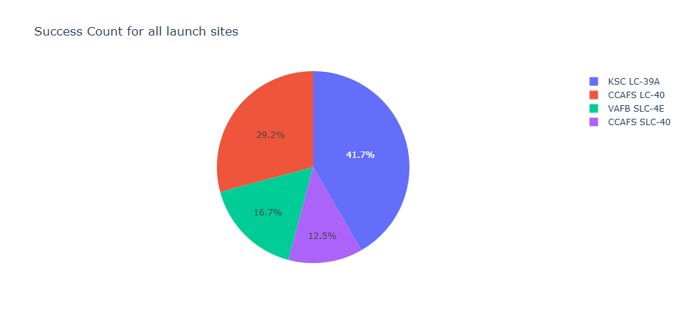
Pie chart showing success percentage achieved by each launch site
Total Success Launches by all sites.
The link to notebook is
https://github.com/Waris99/Final-Capstone/blob/main/app.py

Slide 39
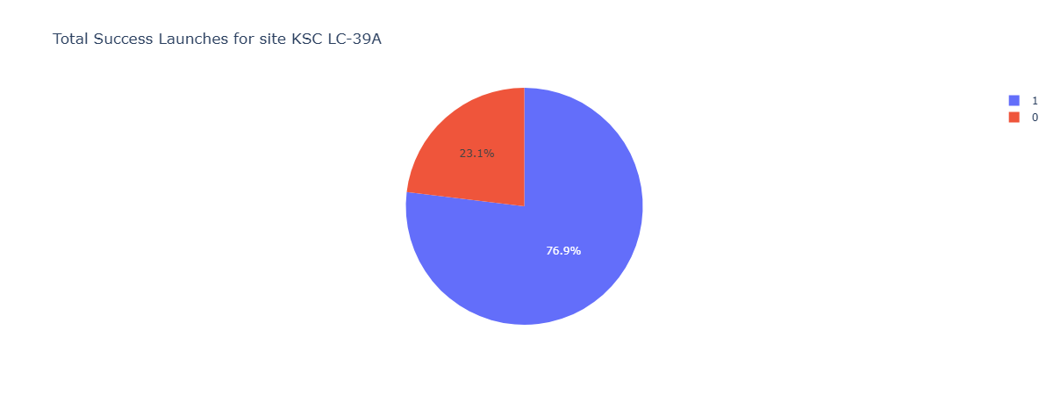
Pie chart showing Launch site with highest launch success ratio
KSC LC-39A has the highest success ratio of 76.9% while getting a 23.1% failure rate

Slide 40
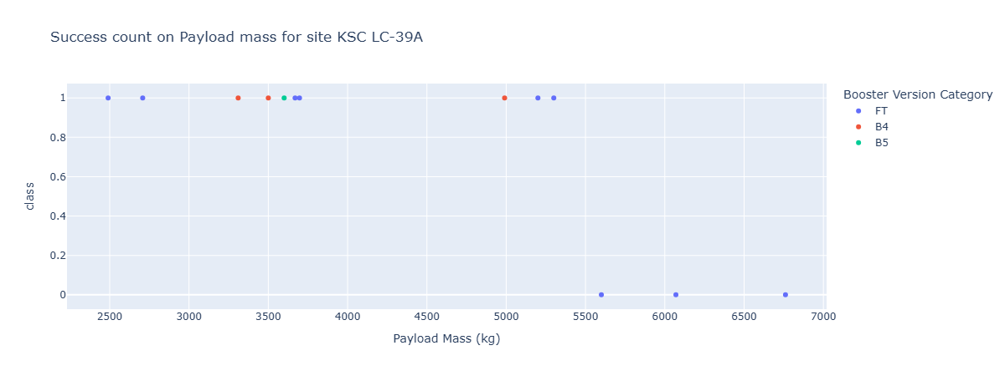
Scatter plot of Payload vs Launch Outcome for all sites, with different payload selected in the range slider
The link to notebook is
https://github.com/Waris99/Final-Capstone/blob/main/app.py

Slide 41
Predictive Analysis

Slide 42
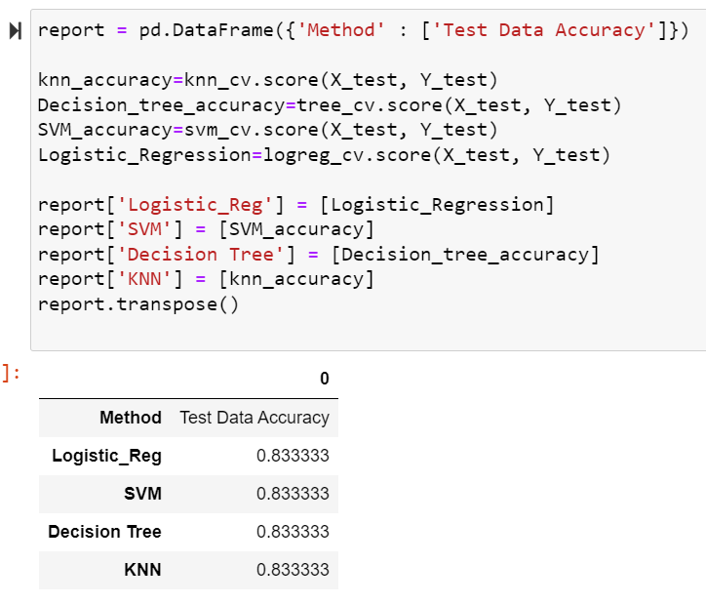
Classification Accuracy
The classification accuracy of all models are as follow

Slide 43
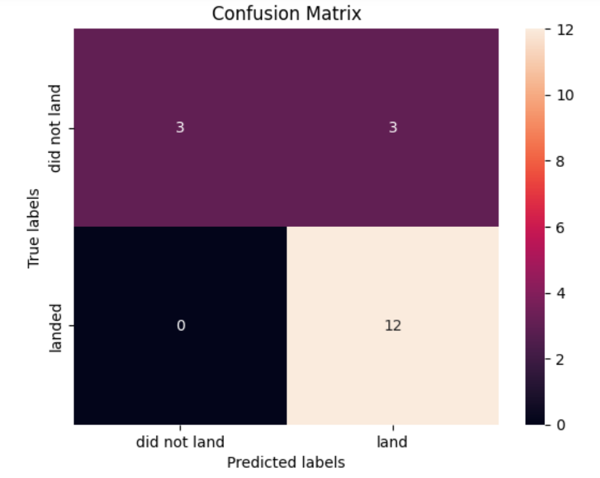
Confusion Matrix
The confusion matrix for the decision tree classifier indicates that it effectively differentiates between the various classes. However, a significant issue is the occurrence of false positives, where the classifier incorrectly labels unsuccessful landings as successful ones.

Slide 44
Conclusions
From all the analysis, we can conclude that:
The larger the flight at a launch site, greater the success rate at a launch site.
Launch success rate started to increase in 2013 till 2020
Orbits ES-L1, GEO, HEO, SSO, VLEO had most success rate
KSC LC-39A had most successful launches of any site

Slide 45
THANK YOU!

